Slide 1

ISIS Neutron training course.
8th March 2018
Molecular Dynamics
Lecture 1: Basic Ideas, Newtonian motion, trajectories, sampling.
David J. Willock
Cardiff University, U.K.

Slide 2
Books
“Molecular Modelling, Principles & applications”, A.R.Leach
“Computer Simulation of Liquids”, M.P.Allen and D.J.Tildesley, Oxford Science Pubs., (1993), ISBN 0-19-855645-4
“Understanding Molecular Simulation”, Daan Frenkel and Berend Smit, Academic Press, (1996), ISBN 0-12-267370-0
“Theory of Simple Liquids”, J.-P. Hansen and I.R. McDonald, Academic Press (1986).
“The Art of Molecular Dynamics Simulation”, D.C. Rapaport, Camb. Univ. Press (2004)
“Classical Mechanics”, H. Goldstein, Addison-Wesley.

Slide 3
What is Molecular Dynamics?
MD is the solution of the classical equations of motion for atoms and molecules to obtain the time evolution of the system.
Applied to many-particle systems - a general analytical solution not possible. Must resort to numerical methods and computers.
Classical mechanics only - fully fledged many-particle time-dependent quantum method not yet available.
Gives time evolution of systems: trajectories. These allow time dependant phenomena, such as diffusion, to be followed.
Maxwell-Boltzmann averaging process for thermodynamic properties (time averaging).

Slide 4
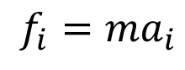
Lennard -Jones Potential
Note that the using a potential cut-off, r_{cut}, implies a discontinuity in f which can be avoided by using a shifted potential.
V(r)
Force due to the potential causes the atoms to accelerate:
$$f_{i}=ma_{i}$$
σ
r
ε
r_{cut}

Slide 5
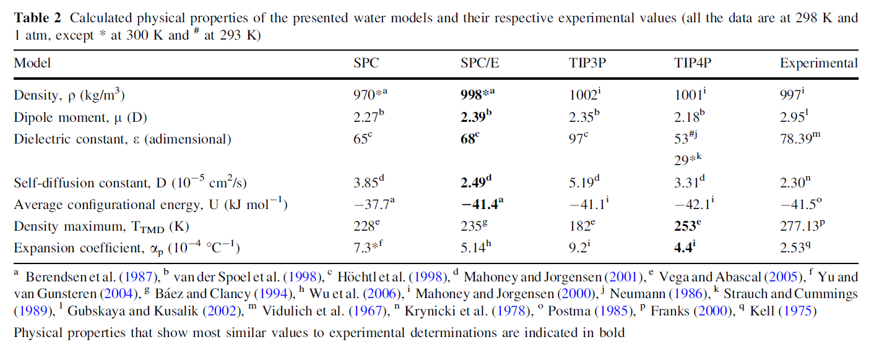
Molecular Dynamics: Physical properties, e.g. water
Molecular dynamics can be used to simulate the collective behaviour of large systems and so provide ensemble averages as estimates of marcoscopic properties.
Water has been studied extensively: Important and accurate experimental data.
Taken from Ozu et al., Eur. Biophys. J. (2013) 42: 223

Slide 6
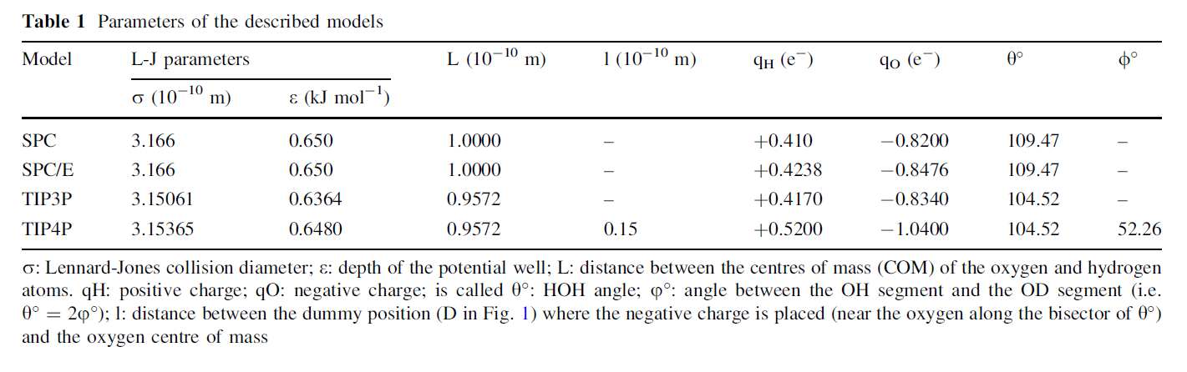
Taken from Ozu et al., Eur. Biophys. J. (2013) 42: 223

Slide 7
Water models: TIP4P and simple three site models
Water TIP4P/2005
UNITS kcal
ATOMS 4
ow 15.9996 0.0000 1
hw 1.00080 0.5564 1
hw 1.00080 0.5564 1
M 0.10000 -1.1128 1
rigid 1
4 1 2 3 4
FINISH
VDW 1
ow ow lj 0.18519 3.1589
close
Part of a DLPOLY FIELD file for TIP4P water.
ATOMS lines read as “mass” “charge” “number”
Additional site marked as “M”
Molecule treated as a rigid body.

Slide 8
Water Models
TIP4P/2005 provides a much more accurate description of liquid water than SPC/E
SPC/E underestimates the temperature at which the density of water has its maximum, so the water structure will be affected.
[6] G. S. Kell, J. Chem. Eng. Data, 20, 97, (1975)

Slide 9
Water/Methanol mixtures.
Even a small amount of methanol alters the properties of the solution by disrupting the hydrogen bonding network.

Slide 10
Taken from Ozu et al., Eur. Biophys. J. (2013) 42: 223

Slide 11
The force on atom i for any given configuration can be calculated from the forcefield. This equation relates force and acceleration.
So for any given configuration we know the acceleration of each particle.
If a particle has an initial velocity, v_{i}(0), and moves under the action of this force for a time, τ, its velocity after the time, τ, will be given by integration.
Similarly the position of the particle after time, τ, is given by an integral of the velocity.
Unfortunately once the particles move the distances governing the potential change and so the forces are altered.
Molecular dynamics is about integrating these equations of motion such that the continuous trajectories are obtained numerically.

Slide 12
Integration: Essential Idea
r’ (t+ τ)
Constant v over τ would follow this path
v (t) τ
r (t+τ)
Net displacement
r (t)
Correction assuming acceleration is constant over τ
f(t)τ²/m
[r(t), v(t), f(t)]
[r(t+τ), v(t+ τ), f (t+ τ)]

Slide 13
The Verlet algorithm (1967).
In a molecular dynamics simulations the configuration at time is split into a series of steps of length, τ, the time step. Information from previous steps can be used to generate future steps.
We have looked at Newton’s laws for the position of any atom at time t+τ. This is the first part of a Taylor expansion:
We could equally well back track to time t-τ by using a negative time step, this would give:
Note: Using further extensions of the Taylor expansion is the basis of the Gear Predictor-Corrector integrator methods (see Allen & Tildesley).

Slide 14
By adding these equations we can remove the need to calculate the velocity at any timestep since:
So the next position for the atom in the trajectory is:
Note that in this scheme the cubic terms in the timestep have been cancelled out and so the error in the interpolation to the next point is of order τ⁴.
This means that the Verlet algorithm will follow the “real” trajectory of the system more accurately than a simple scheme based on the velocity and force equation for r_{i}.

Slide 15
Minimum Image Convention
For van der Waals interactions use only the nearest images of atoms.
r_{cut}
This means that the simulation cell size has to be sufficient so that the potential cut off is less that half the shortest simulation cell dimension.
Generally r_{cut} in the range 8 – 15 Å is required to converge the potential calculation.
i
r_{ij}
r_{ij’}
a
j
j’
b
Use r_{ij’} not r_{ij} for the interaction of atom i and j.

Slide 16
Key Stages in MD Simulation
Set up initial system positions of atoms and initial velocities (Boltzmann with random directions)
Calculate atomic forces based on potential model.
Calculate atomic motion via the integration algorithm, e.g. Verlet.
Calculate physical properties
Repeat !
Produce final summary
Initialise
Forces
Motion
Properties
Summarise

Slide 17
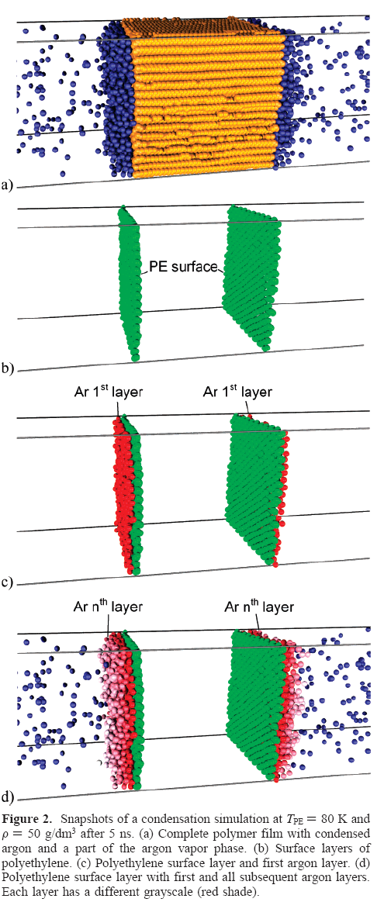
Lennard-Jones Spheres (Argon).
Provides a relatively simple system in which the ideas of using molecular dynamics to study kinetics and thermodynamics of physical processes can be tested.
Here a simulation of Ar condensation at the surface of a polyethylene film is simulated.
System size: Film consists of 374 chains, 70 sites each. Vapor phase: 5000 argon atoms.
Run times: 1ns equilibration of components.
12 ns run times.
R. Rozas & T. Kraska, J. Phys. Chem. C, 111, 15784, (2007).

Slide 18
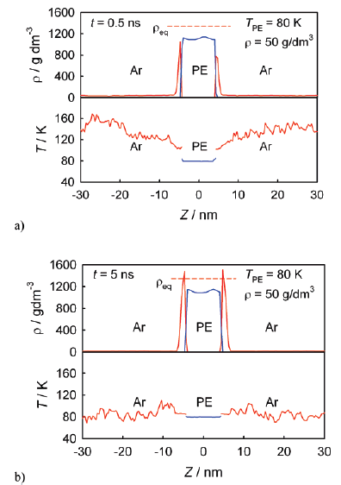
System Properties (1)
Thermodynamic Properties MD Kinetic Energy:
The average <...> kinetic energy per particle is directly related to the statistical mechanics definition of temperature:
Data from: R. Rozas & T. Kraska, J. Phys. Chem. C, 111, 15784, (2007).

Slide 19
Velocity scaling
To get around the problem of temperature drift we can simply remove or inject kinetic energy by scaling the velocities in the initial stages of the calculation:
Where T(set) is the target temperature for the simulation. This technique is referred to as velocity scaling and is used during the equilibration period of the simulation.
Example MD run with T set at 300K, velocity scaling used up to 5ps.
Thereafter fluctuations in T increase but no drift away from average.
Temperature / K
Time / ps

Slide 20
Radial Distribution Function, RDF
The radial distribution function is the probability of finding a pair of atoms a distance r apart relative to the probability for a completely uniform distribution.
Volume of the sampling shell:
Edge of simulation cell
δr
If this were a perfectly uniform distribution the number of particle pairs at a particular r will depend on the concentration and volume of space sampled:
r
To calculate distances in this region requires min. image
Num pairs per unit volume
Volume sampled at r.

Slide 21
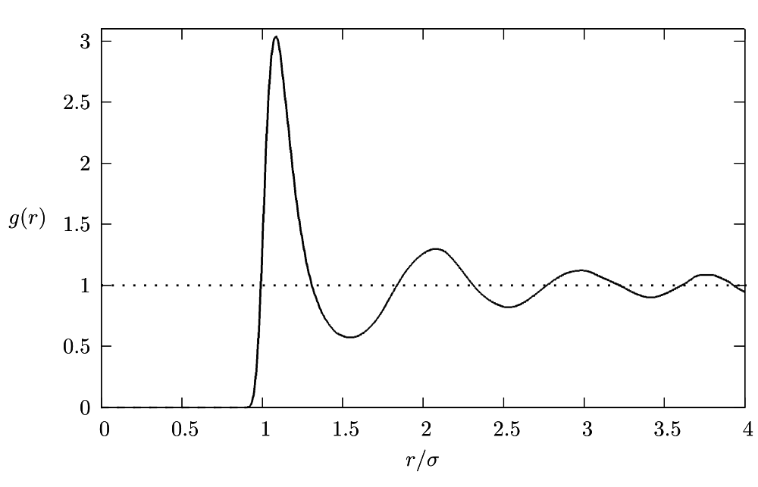
Radial distribution function
The radial distribution function is calculated for each frame and then averaged:
The function indicates if there is local structure in the fluid. A uniform distribution of particles would have g(r) = 1 for all r.
So accumulation of particles shows up as g(r) > 1 and depletion as g(r) < 1.

Slide 22
Radial Distribution Functions
Peaks show the distances of the first, second etc. neighbours
Narrow peaks indicate that the system is more ordered
Integrating the radial distribution functions to their first minima allow us to calculate the average number of hydrogen bonds formed by each molecule.

Slide 23
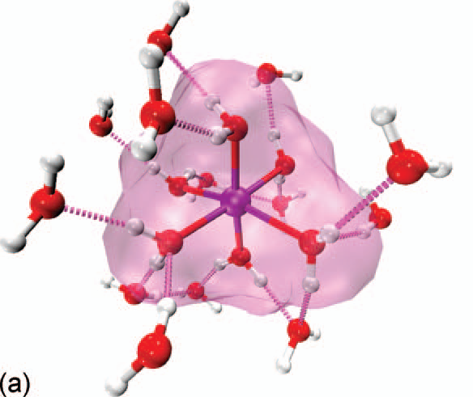
Information from Radial Distribution Functions.
Example DFT-MD/ QM-MM calculation of the distribution of H₂O around a Zn²⁺ cation.
Note:
First g_{Zn-O}(r) peak integrates to 6. (co-ordination Nº )
QM/MM combination captures g_{Zn-O}(r).
Orientation of water in first solvation shell leads to depletion in g_{Zn-O}(r) between 2.5 and 3.5 Å.
E. Cauët et al., J. Chem. Phys. 132, 194502, (2010)

Slide 24
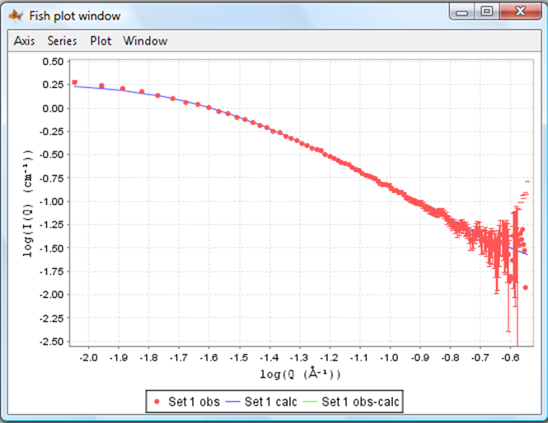
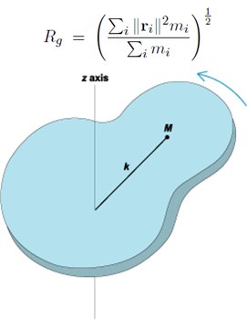
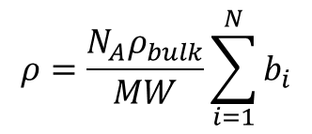
SANS data
N-(2-hydroxypropil) methacryleamide (HPMA) is a polymer used as carrier in drug delivery systems.
MD compared with small angle neutron scattering (SANS) data.
Log (I(Q) / cm⁻¹)
Log (Q / Å⁻¹)

Slide 25
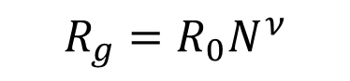
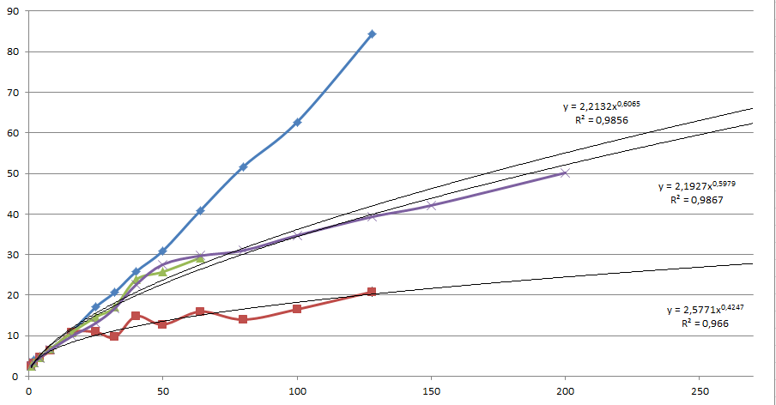
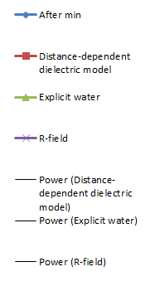
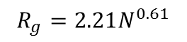
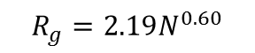
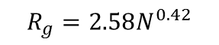
Flory power law approximation
Flory used self avoiding random walks to show that a polymer conformation should be expected to lead to a radius of gyration that depends on monomer number via a power law:
With ν = 0.6 for a “good” solvent
90
80
minimisation
explicit water, R_{g}(265)= 66 Å
70
60
50
R_{g}, nm
40
React. field, R_{g}(265)= 62 Å
30
20
10
Dist. dielectric, R_{g}(265)= 27 Å
0
50
100
150
200
250
N (number of HPMA monomers)
SANS: HPMA-265, R_{g} = 75 ± 3 Å

Slide 26
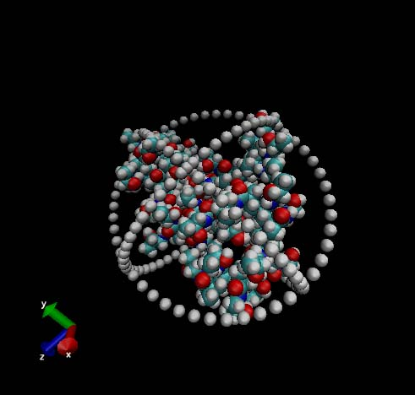
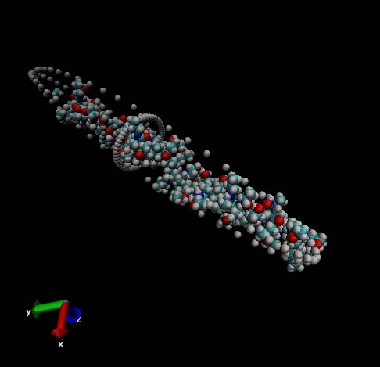
Shape Information: Moments of inertia
Neutron scattering is controlled by the scattering length density:
Ellipsoid dimensions:
R_{X} / R_{Z} = 0.36
R_{Y} / R_{Z} = 0.43
R_{Z} / R_{Z} = 1.00
R_{X} / R_{Z} = 0.02
R_{Y} / R_{Z} = 0.02
R_{Z} / R_{Z} = 1.00
To describe the observed “shape” we can use the scattering factors, b_{i}, in place of mass in the moment of inertia matrix.
This allows us to define a set of axes and determine the dimensions of an ellipsoid that represents the shape using the furthest atom distance in each direction at each frame of the MD trajectory.

Slide 27
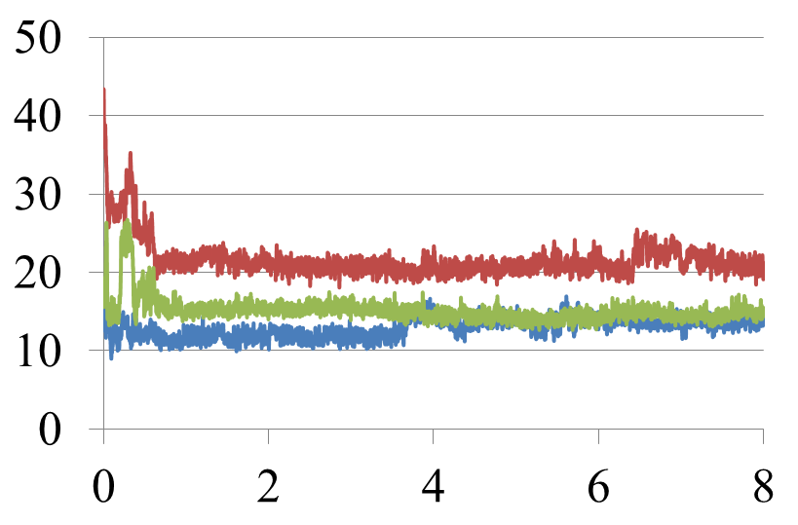
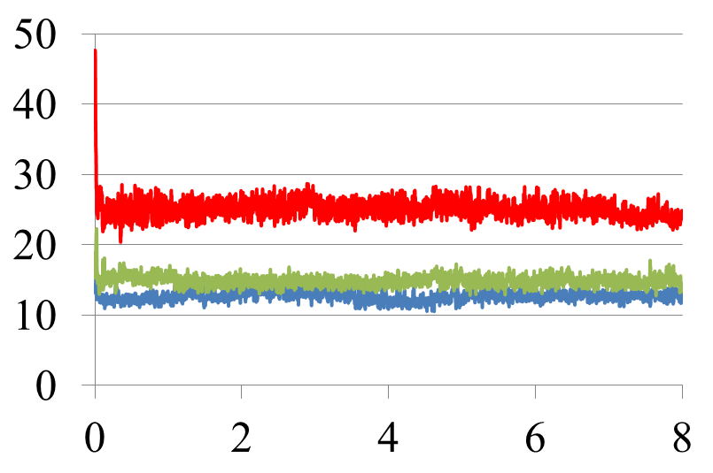
HPMA-50 comparison of starting points
R / Å
HPMA-50, MOE built
MD runs comparing elongated (MOE) and Zebedde generated start points.
NVT ensemble, 310 K,
AMBER99 forcefield
Reaction field implicit water (ε = 80.1).
MOE start point eventually gives more spherical polymer shape.
Zebedde start point rapidly achieves constant shape parameters.
E_{tot} 56.4 kcal mol⁻¹, (monomer)
R_{Z}
R_{X}, R_{Y}
t / ns
R / Å
HPMA-50, Zebedde start point
E_{tot} 57.7 kcal mol⁻¹, (monomer)
R_{Z}
R_{X}, R_{Y}
t / ns

Slide 28
Comparison with SANS data
Conjugate | Vol. Calc. / 10⁵ Å³ | Vol. SANS / 10⁵ Å³ | V_{SANS}/V_{calc} | Aspect ratio calc. | Aspect ratio SANS
HPMA-C6-F-10 | 1.275 | 1.024 | 0.803 | 2.56 | 4.83
HPMA-C8-OH-10 | 1.232 | 1.024 | 0.831 | 1.95 | 4.83
HPMA-C6-OH-10 | 1.122 | 1.125 | 1.003 | 1.70 | 4.38
HPMA-C6-10 | 1.052 | 2.658 | 1.975 | 1.43 | 3.48
HPMA-C12-5 | 1.196 | 7.654 | 6.397 | 1.54 | 7.80
The volume from the MD ellipsoids and cylinders fitted to SANS measurements show reasonable agreement for first three cases.
For HPMA-C6-10 and HPMA-C12-5 cases data suggests that there is agglomeration of polymer in the experimental case.
Aspect ratios for single chains show more elongated structures than would be expected from the simulations.

Slide 29
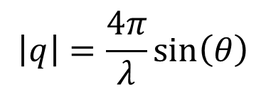
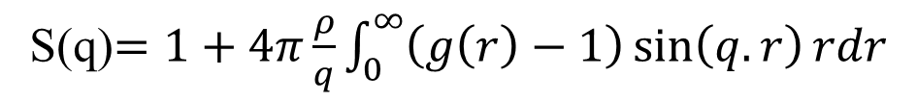
Relationship between RDF and scattering experiments.
In scattering experiments the scattering of radiation or neutrons as a function of the wavelength is studied to gain structural information.
The wavelength information is contained in the scattering vector, q.
For scattering through 2θ with respect to the incident beam.
S(q)$=1+4π\frac{ρ}{q}\int_{0}^{∞}{\left(g\left(r\right)−1\right)\sin\left(q.r\right)rdr}$
The structure factor is effectively a Fourier transform of the radial distribution function which picks out the density modulation at a particular reciprocal space vector, q.
The meaning of the density varies according to the scattering being considered.
From a scattering study for the structure of Lysozyme by Merzel and Smith, Acta. Cryst. D, 58, 242, (2002).

